Slide 1

University of Asia Pacific
Department of Computer Science & Engineering (CSE)
Course Title : Project Management & Strategy
Course Code: CSE 307
Topic : Project vs Project Management
Presented by:
Tamanna Sultana
ID-22201059
Taposhi Rabeya Bashar
ID – 20101060
Mahinur Akter
ID- 22201100
Presented to:
Dr. Subhra Prosun Paul
Assistant Professor
Department of CSE
University of Asia Pacific

Slide 2
Outline
1. Introduction
2. Objective
3. Understanding of Project
4. Understanding of Project Management
5. Key Differences Between Project & Project Management
6. Phases of a Project Lifecycle
7. Example of Project
8. Five Basic Functions of Management
9. Example of Project Management
10. Analysis & Discussion
11.Conclusion & Q&A

Slide 3
Introduction
Project
The "What" (Goal, Deliverable)
Project Management
The "How" (Process, Execution)
A project is the destination, project management is the journey!

Slide 4
Objective
Understand the difference between a project and project management
Explore the key phases of the project
Recognize the importance of both project and project management
Learn how structured management ensures project success

Slide 5




What is a Project?
Temporary
Unique output
Projects have a defined beginning and end
Each project creates something distinct
Defined objectives
Specific timeframe
Clear goals that must be achieved
Set duration with deadlines
Example: Building a new website

Slide 6
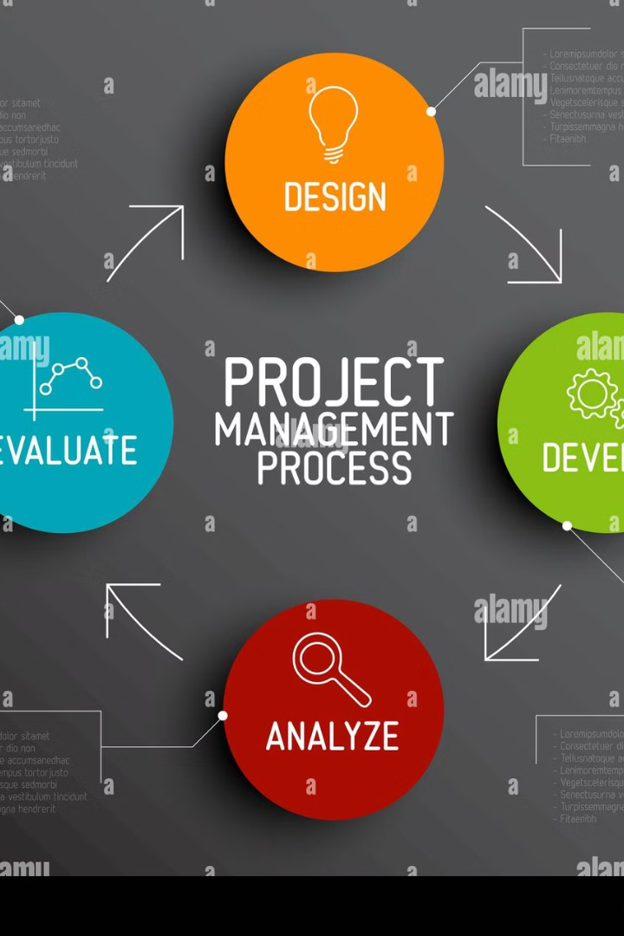




What is Project Management?
Planning
Setting goals and creating roadmaps
Execution
Implementing the planned activities
Monitoring & Controlling
Tracking progress and making adjustments
Closing
Finalizing deliverables and reviewing outcomes
Example: The structured process to ensure the website is completed on time and within budget

Slide 7
Key Differences Between Project & Project Management
Aspect
Project
Project Management
Purpose
Deliver a product, service, or result
Ensure the project is completed efficiently
Duration
Temporary
Ongoing until project completion
Focus
The final outcome
The process and methodology
Tools
Deliverables, goals
Plans, schedules, and frameworks

Slide 8










Phases of a Project Lifecycle
Plan
High-level project planning
Program
Group of related projects
Project
Specific initiative with deliverables
Work package
Manageable components of work
Task/Activity
Individual actions to complete

Slide 9



Example of Project :
Project Name
Developing a Mobile App for Online Shopping
Scope
Design, develop, integrate, implement
Outcome
A fully functional mobile app
Scope:
Design a user-friendly interface
Develop Android and iOS versions
Integrate payment gateways
Implement user accounts and order tracking

Slide 10










Five basic function of management
Organizing
Planning
Arranging tasks, people and resources
Setting objectives and courses of action
Staffing
Recruiting and training team members
Controlling
Monitoring and correcting activities
Leading
Motivating and guiding the team

Slide 11





Example of Project Management
Planning
Organizing
Staffing
Leading
Assign tasks.
Hire professionals.
Conduct meetings.
Controlling
Test and refine product.
Project Management for the Mobile App Development Project
Define app purpose.

Slide 12
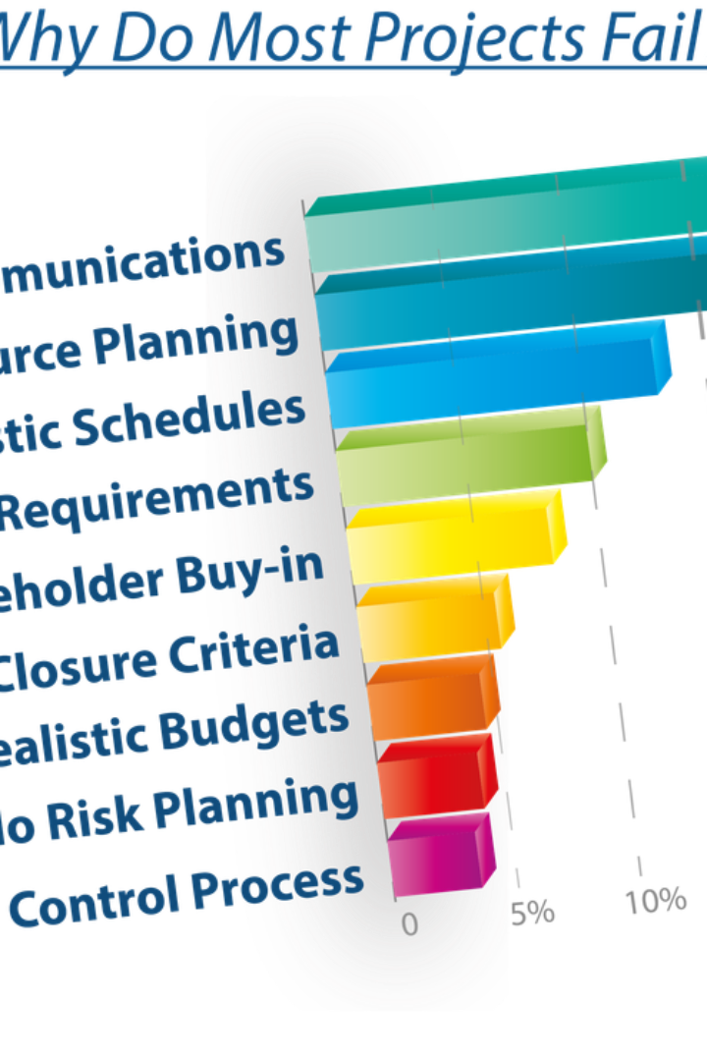
Analysis
Project without management
A project without project management can fail due to poor planning
Management without clear goals
Project management without a clear project goal is ineffective

Slide 13
Conclusion
Project drive innovation and create value
Project Management ensures efficiency, organization, and success.
Both are essential for delivering results on time, within budget, and at high quality

Slide 14
Thank You

Slide 15
Reference
1. ProjectManager.com-"What’s the Difference Between a Project and a Program?"
2. Fluid.work – "Managing Projects vs. Project Management"
3. PRINCE2 – "Projects and Project Management (PDF)"

